Slide 1
Character Dataset-Based
AI Tools for Creative Process and Transmedia
SD5976
AI Photobooth
Interactive character-based photobooth powered by AI
By: Animal Party
24120309g CAI Qiqing
24058432g LI Yizhen
24122973g WEI Hanrui
24040027g XUAN Yujie
Date: 25th April, 2025
Notes:
Hey, everyone! This is the project AI Photobooth from animal party.
It is all about making a cool, personalized virtual interactive photobooth experience.

Slide 2
Project Overview
Immersive photobooth experience with AI-generated characters
Image Generation Capabilities of ComfyUI
+
Interactive Interface in Touchdesigner
Notes:
We're using resourses from our shared character library and integrate them with the image generation capabilities of ComfyUI and the interactive interface design in TouchDesigner.

Slide 3
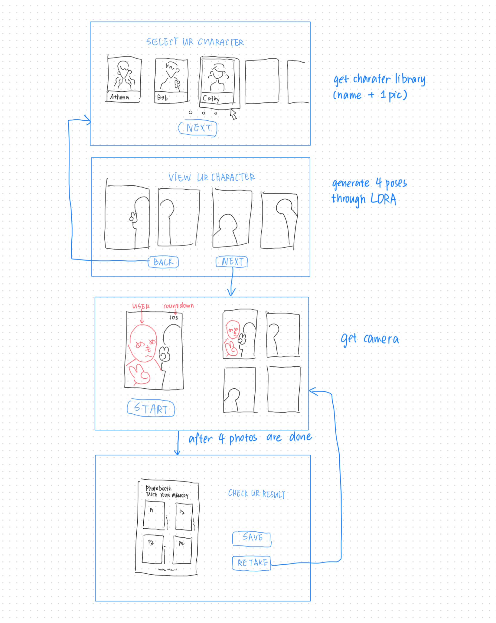
System Pipeline
1. Character Selection (TouchDesigner)
2. AI Character Pose Generation (ComfyUI)
3. Live Camera Capture
4. Display & Save
Notes:
The overall process is that, users can choose a character from our library. The system will then generate images of the selected character in various poses, capture and process the user's real-time image. Finally, it combines the user and the virtual character to produce images in photobooth layout, so users can take a virtual selfie with their favorite characters.

Slide 4
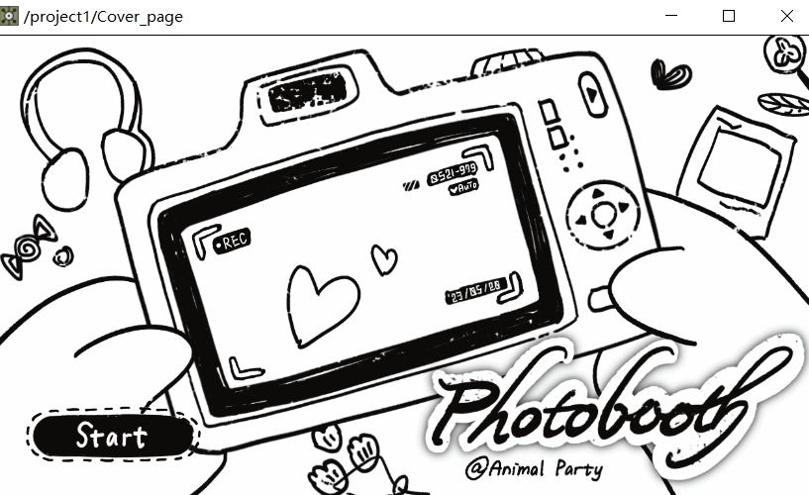
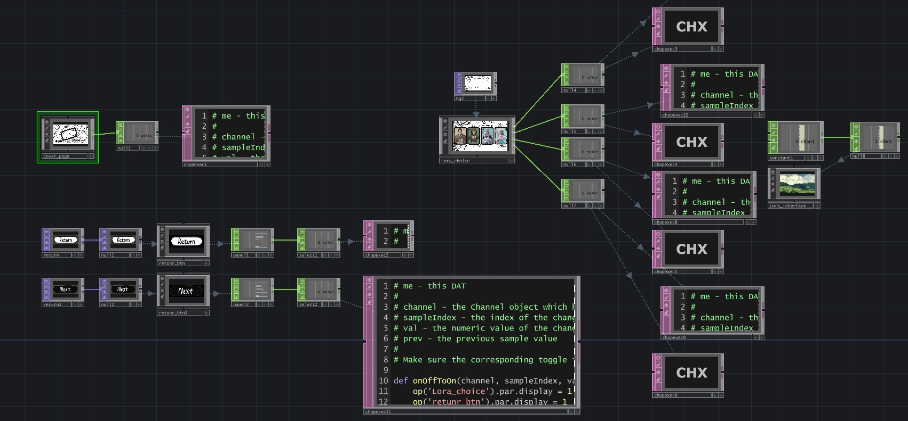
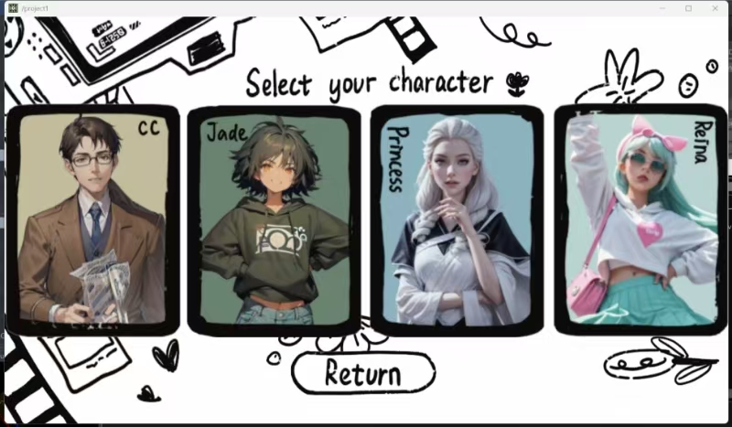
Step 1 - Character Selection
Button functions
Character lora selection
Notes:
We built the character selection interface in TouchDesigner.
Firstly we have the cover page here. we use nodes like panel and select to make the buttons work. They make sure the signals get sent right, so the interface switches and the process moves forward.
we show the characters as little thumbnails with their name and appearance.
we added a Panel CHOP to each character box to transform the Lora data.
When a user clicks a character, the script runs and writes the LoRA file path for that character into a Constant CHOP. it reads this to know which character was picked.

Slide 5
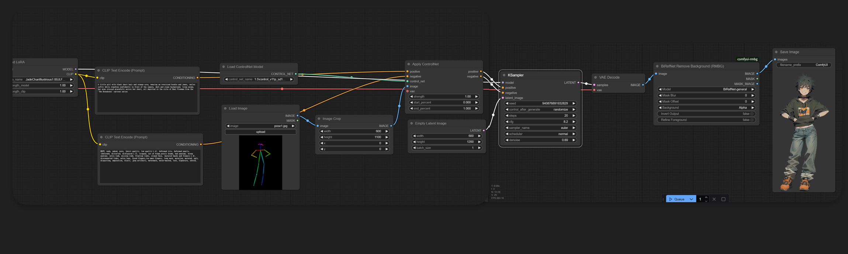
Step 2 - AI Pose Generation
Character Pose Control
ControlNet model: OpenPose
Pose Reference Image “Stick Figure”
ComfyUI
Notes:
Next stage of pose generation, we load a Openpose ControlNet model In ComfyUI to transform a pose reference image to a "stick figure". This makes the output image follow the pose exactly, while still matching the text description and the character's look.

Slide 6
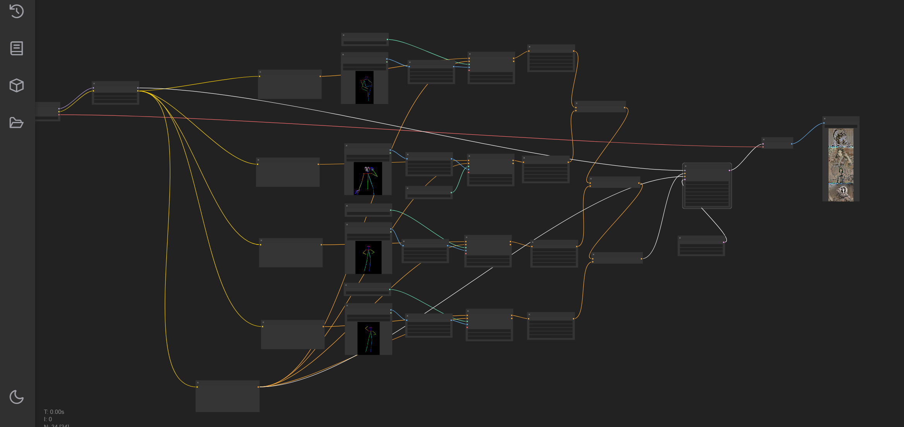
Step 2 - AI Pose Generation
Multi Pose Generation
Conditioning(combine)
4 Different Poses
ComfyUI
Notes:
This ComfyUI setup makes four different poses of the same character. We load one character's LoRA and some shared text prompts to keep the character looking the same. Then, we split the process into four separate paths.
Each path gets a different pose reference image. This results in four different poses of the same character stitching together by the conditioning node.

Slide 7
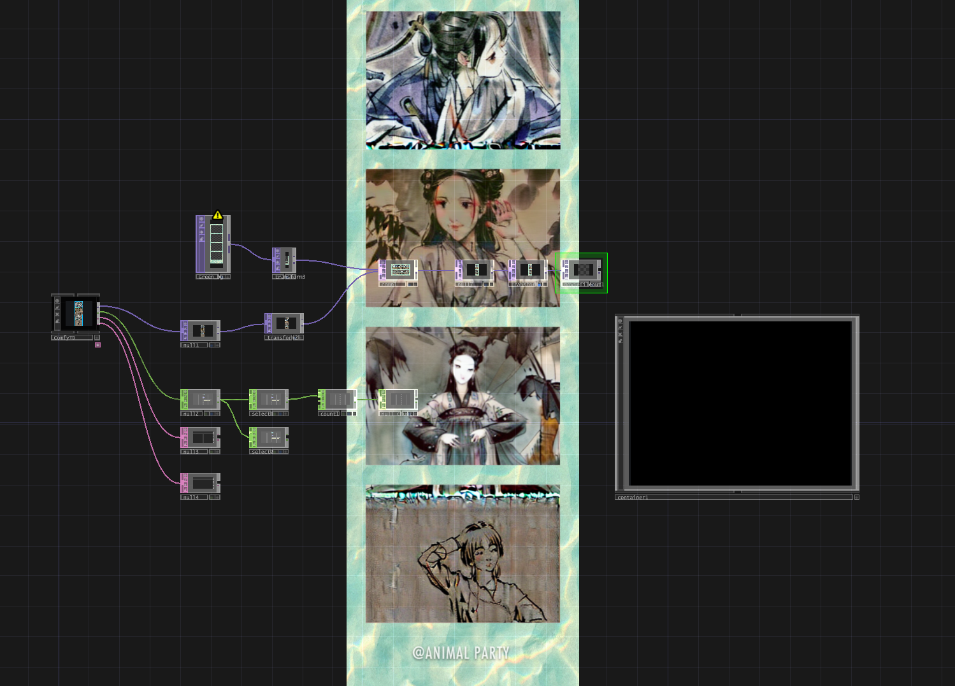
Step 2 - AI Pose Generation
Multi Pose Generation
TouchDesigner
Notes:
Then, this images get sent back to TouchDesigner by using a plugin.

Slide 8
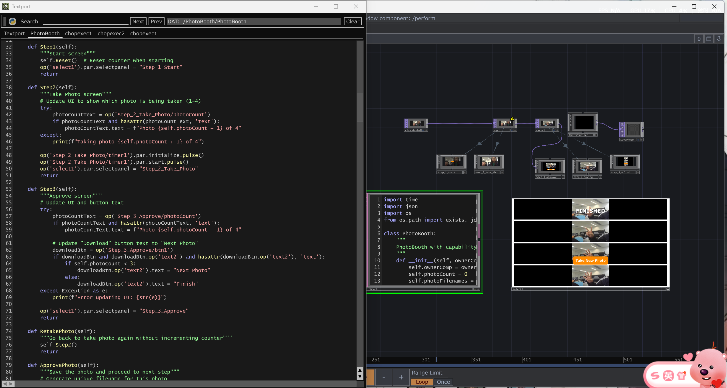
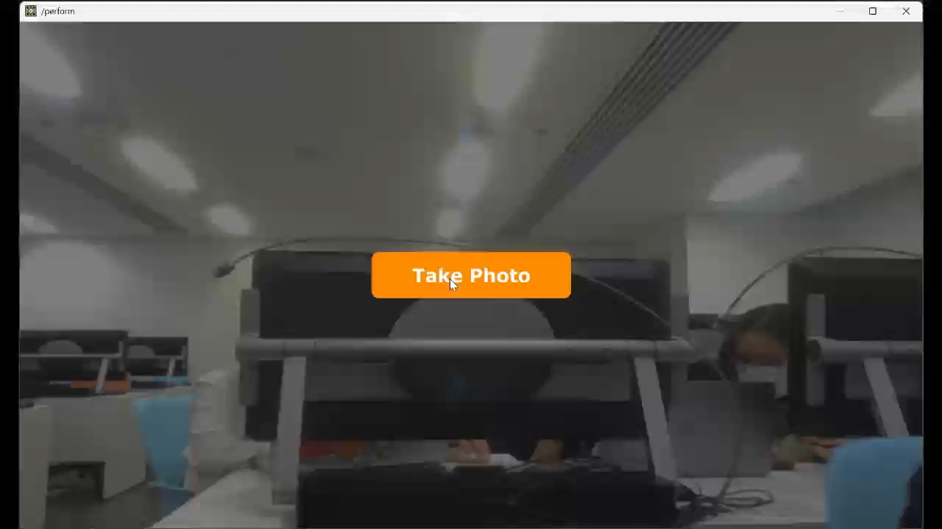
Step 3 - Camera Capture
Photo taking sequence
Notes:
Achieving Camera Capture function is one of the most challenging part since it need to take 4 photos and put it together. Here we use code to navigate the process.
First, the Step1 function resets the counter and shows the start screen. Next, the Step2 starts the timer. Then, Step3 switches to the approval interface. If the user wants a retake, the RetakePhoto function returns to the photo-taking step without incrementing the count. If you are satisfied with it, click next photo. ApprovePhoto function saves the photo, and repeats the process until 4 photos are taken.
Here we have a magical step 5 to deal with the restart problem. we implemented a RestartPhotoBooth method. which connected to the "Take New Photo" button, enabling users to restart the photo sequence.

Slide 9
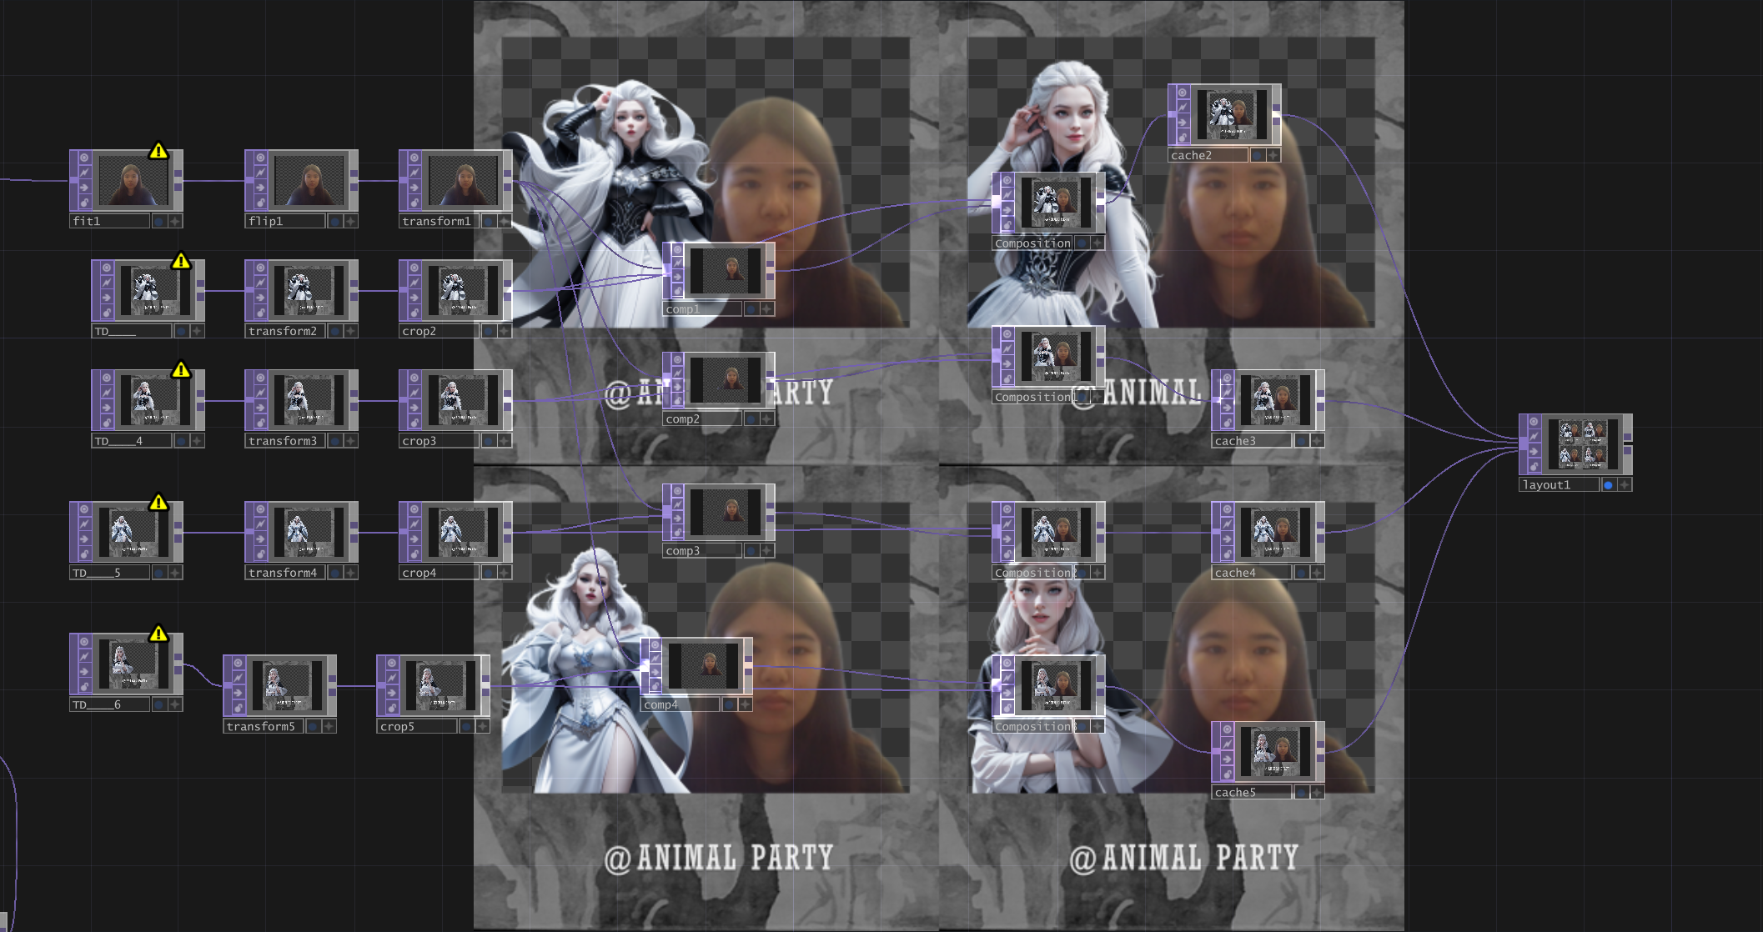
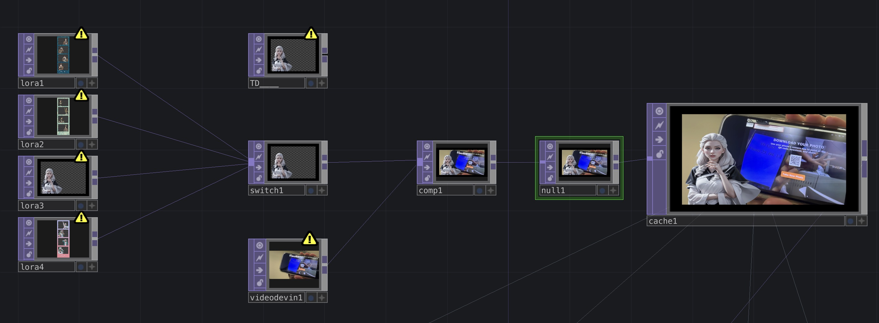
Step 4 - Final Composition
Cross network component access
Some attempt
Workable version
Notes:
Solved problem no.1 now to problem no.2. we need to bring character layout together. We ve also faced a cross - network component access challenge. The main PhotoBooth network needed to access Lora character assets in a different network at /project1/Lora_interface/.To solve this, we used a Select TOP as a bridge between the networks. We employed absolute paths to accurately reference the character models, to get successful access to the Lora assets.
although We got the user photo and character poses to work together, it still needs further adjustment to change character pose between each photoshooting.

Slide 10
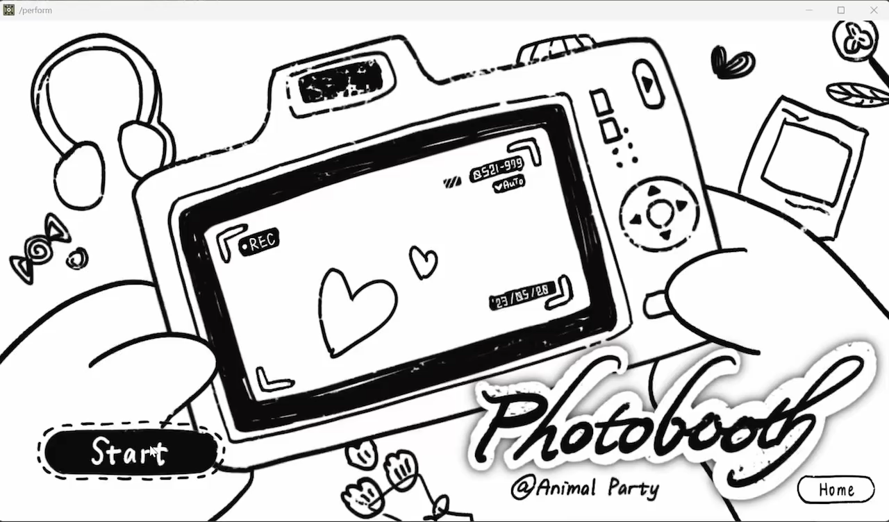
Final result
Notes:
But for now Lets check the final result.
Start our photobooth journey, choose the character in library and take photo! If you are satisfied with it, just click next, otherwise you can retake it. Then you get the final picture with your favorite character. Click new photo to start all over again.

